Slide 1
Providing Feedback that Works in a Changing Workplace
Aaron Brink, Psy.D. & Tiffany Tiberi, Psy.D.

Slide 2
Overview
Framing Feedback
Strategies
1
2
Discussion
Next Steps
3
4
Considerations, challenges, and opportunities
Effective feedback, addressing bias, and integrating multiple types of feedback
Return to large group to discuss actions
Breakout groups to share and learn from one another
Notes:
Disclaimer about privacy, what’s talked about here stays here-personal nature of feedback

Slide 3
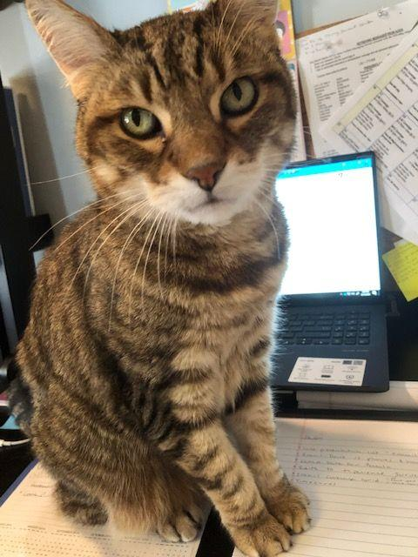
Tiffany Tiberi, PsyD (she/her/hers)
Associate Director, Loyola University Chicago
Staff of 18 - I supervise 9
Integrated center
Executive Director-NP
3 Associate Directors (Mental health/Medical/Health promo)
Mental Health
Director of Counseling
Associate Director of Counseling

Slide 4
Aaron Brink, PsyD (he/him/his)
Associate Director, UNC Charlotte
Staff of 19 - I supervise 5
Not integrated with Student Health
Administrative team of Director and 4 Associate Directors
Administrative supervision of staff is divided among Associate Directors

Slide 5
Framing feedback
Feedback: Telling people what we think of their performance and how they should do it better
Can hinder performance if not delivered/received well
Self-centered/focus on what I think is right/ biased
Assumes “great performance” is universal regardless who who the person is
Instruction: Telling people what steps to follow or what factual knowledge they are lacking
We should be asking: “How can I help each person thrive and excel?”

Slide 6
Different types of feedback about different things…
Processes
Clinical Skills
Workplace Behavior
Developmental
Motivational

Slide 7
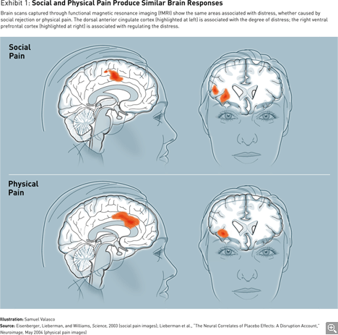
Your brain on feedback
Fight or flight
Brain’s job is to minimize threat and maximize reward
Saying “Can I give you some feedback” is the cortisol equivalent of hearing footsteps in the dark
Fairness: Perception that an event is unfair triggers strong response in the limbic system

Slide 8
Empathy and feedback
Research suggests more empathic leaders are also more likely to experience decreased attention and increased distress following delivery of negative feedback
This may mean that more recovery time is needed when negative feedback is delivered
If you tend to be more empathic, you may consider scheduling feedback delivery later in the day and/or planning a recovery activity following feedback

Slide 9
Bias and inequity in feedback
What we know about bias
Idiosyncratic Rater Effect - More than half of our evaluation of another person is reflecting our own characteristics rather than some objectively true rating
Our own biases will also shape what we give feedback on and what ignore
White supremacy culture
Tendency to ground feedback in values of perfectionism, quantity over quality, worship of the written word, and progress = bigger/more
Feedback delivery grounded in defensiveness, paternalism, either/or thinking, objectivity, and right to comfort
Intention vs impact

Slide 10
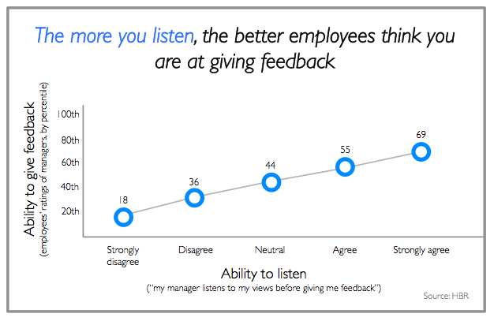
Strategies for effective feedback
Order of praise and constructive statements may not matter
What does matter is the interpersonal skills of the feedback giver-genuine, engaging kind and clear
How might this feedback be shaped by my own cultural background or style preferences?
Be specific and connect to goals
Be a good listener
Environment matters
Notes:
-

Slide 11
Strategies for effective feedback
Focus on behavior, not the person
Highlight what went well, acknowledge the intention
Feedback shows a way to improvement
Meet regularly
Notes:
-

Slide 12
Integrating multiple forms of feedback
Formal evaluation
Pros: Consistent, regularly scheduled, structured
Cons: One-size-fits-all, not timely, tied to other consequences, “permanent record”
Data-based feedback
Pros: Specific, consistency across staff, acknowledges work not seen
Cons: Missing context, impersonal, comparison to “average,” emphasizes amount rather than quality, false sense of objectivity
Informal feedback
Pros: Reduced pressure, less “we need to talk” vibes, built into relational approach
Cons: Receiver may feel caught off guard, can impact clarity of feedback, can be avoidant
360 feedback
Pros: Helps understand strengths/weaknesses, multiple sources, tailor it to specific goals, can increase safety in sharing anonymous/group feedback
Cons: Significant time/training needed, can be vague, can turn into outlet for grudges/grievances

Slide 13
Discussion Questions
We will enter into small breakout groups. Use this chance to share, learn, and connect around this part of our jobs. Feel free to use the following prompts to guide discussion:
What is a clinical director’s role in providing feedback in your center?
How do shifting workplace norms impact use of feedback in your center?
What challenges do you encounter in providing feedback?
What has worked?

Slide 14
Thank you!
Tiffany Tiberi, PsyD ● ttiberi@luc.edu ● Loyola University Chicago
Aaron Brink, PsyD ● aaron.brink@uncc.edu ● University of North Carolina at Charlotte

